Slide 1

Mathematical modelling for vaccine-preventable diseases
Dynamic models lecture 1
Differential equations
Katy Gaythorpe
School of Public Health
Imperial College London
k.gaythorpe@imperial.ac.uk
Notes:
Introduce who we are

Slide 2
Outline
What are differential equations?
What can they do for us?
The modelling process
Examining mathematical models
Construct your own differential equation models
How computers solve differential equations

Slide 3
What are differential equations?
Equation for the rate of change of an unknown or dependent variable as a function of a known or independent variable, itself and model parameters

Slide 4
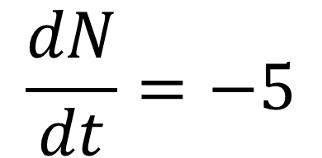
What are differential equations?
Equations with derivatives in them
$$\frac{dN}{dt}=−5$$
We will deal with ordinary differential equations. These are where the derivative only depends one variable i.e. N is a function of t only.
Rate of change in N

Slide 5
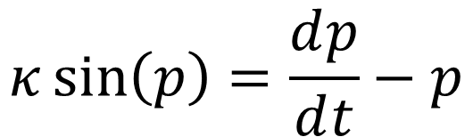
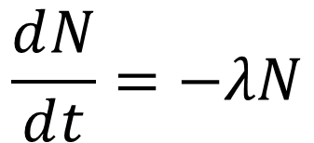
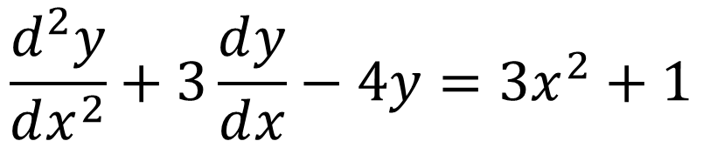
What are differential equations?
Equations with derivatives in them
$$\frac{ⅆN}{ⅆt}=−λN$$
$$κ\sin\left(p\right)=\frac{ⅆp}{ⅆt}−p$$
$$\frac{ⅆ^{2}y}{ⅆx^{2}}+3\frac{ⅆy}{ⅆx}−4y=3x^{2}+1$$

Slide 6
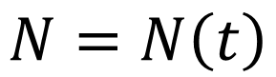
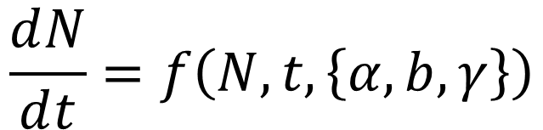
What are ordinary differential equations?
Equation for the rate of change of an unknown or dependent variable as a function of a known or independent variable, itself and model parameters
$$\frac{ⅆN}{ⅆt}=f\left(N,t,\left\{α,b,γ\right\}\right)$$
$$N=N\left(t\right)$$

Slide 7
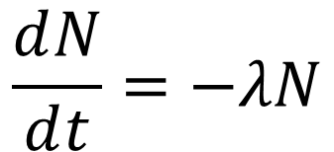
What can they do for us?
Describing a piece of reality through mathematical shorthand can help us understand what is going on
Radioactive decay
$$\frac{ⅆN}{ⅆt}=−λN$$
N=Number of particles
λ= rate of decay
t=time

Slide 8
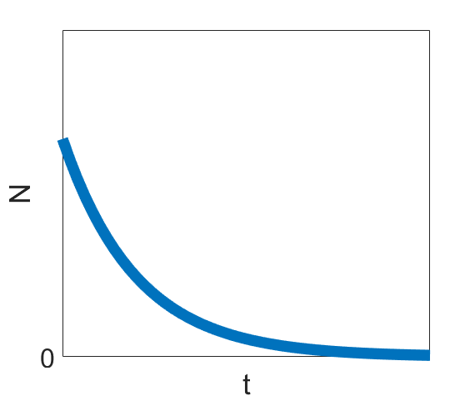
What can they do for us?
Describing a piece of reality through mathematical shorthand can help us understand what is going on
Radioactive decay
$$\frac{ⅆN}{ⅆt}=−λN$$

Slide 9
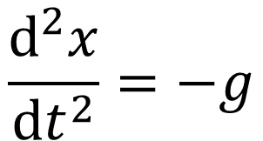
What can they do for us?
Objects falling due to gravity
$$\frac{ⅆ^{2}x}{ⅆt^{2}}=−g$$
x=Position of apple
g= Acceleration due to gravity

Slide 10
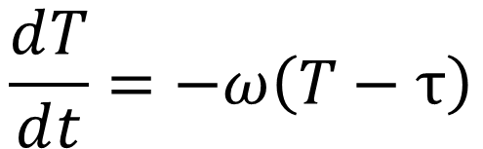
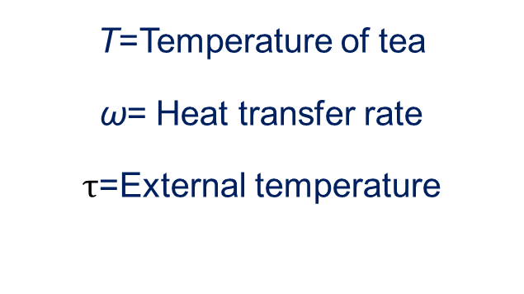
What can they do for us?
Cooling of an object
$$\frac{ⅆT}{ⅆt}=−ω\left(T−τ\right)$$
T=Temperature of tea
ω= Heat transfer rate
$τ$=External temperature

Slide 11

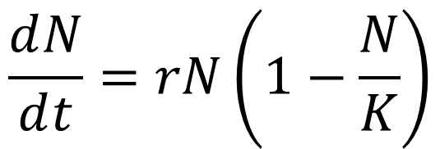
What can they do for us?
Population growth
$$\frac{ⅆN}{ⅆt}=rN$$
N= Number of bacteria
r= Growth rate
K= Carrying capacity
$$\frac{ⅆN}{ⅆt}=rN\left(1−\frac{N}{K}\right)$$

Slide 12
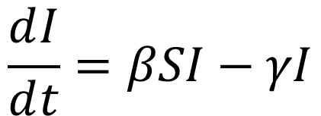
What can they do for us?
Epidemiology
S
I
R
$$\frac{ⅆI}{ⅆt}=βSI−γI$$
S=Number of susceptible people
I= Number of infected people
β= Contact rate
γ= Recovery rate

Slide 13
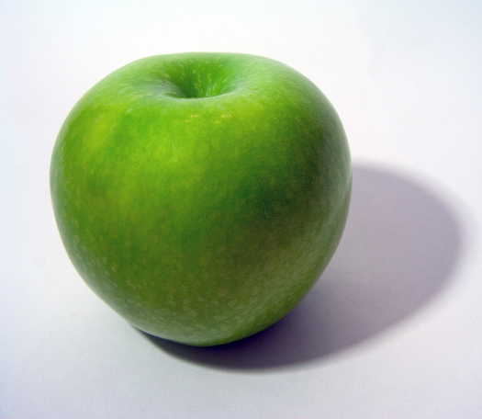
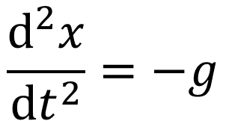
Modelling process
Construction
Reality
Mathematical model
Abstraction
$$\frac{ⅆ^{2}x}{ⅆt^{2}}=−g$$

Slide 14
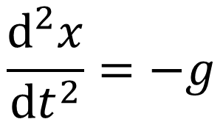
Modelling process
Insight
Mathematical model
Abstraction
Reality
$$\frac{ⅆ^{2}x}{ⅆt^{2}}=−g$$

Slide 15
Examining mathematical models
Solve
Simulate

Slide 16
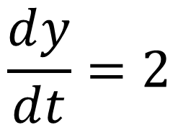
Solving differential equations
$$\frac{ⅆy}{ⅆt}=2$$
Solve

Slide 17
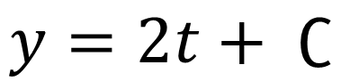
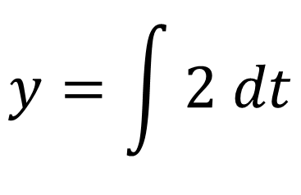
Solving differential equations
$$y=\int{2 dt}$$
Solve
$$y=2t+ ∁$$

Slide 18
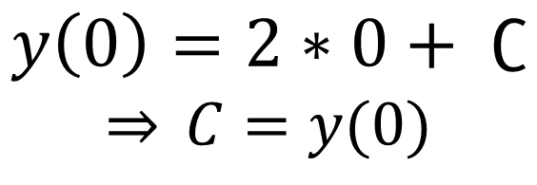
Solving differential equations
$$y=\int{2 dt}$$
Solve
$$y=2t+ ∁$$
$$y\left(0\right)=2∗0+ ∁$$
$$\overset{⇒}{} C=y(0)$$

Slide 19
Solving differential equations
Separation of Variables
Integrating factor form
Auxiliary equation
Trial solutions
Variation of parameters
Solve
However, only work for relatively simple differential equations
and sometimes we are more interested in other characteristics.

Slide 20
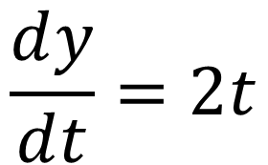
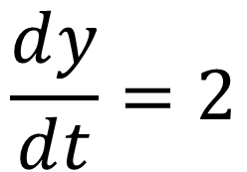
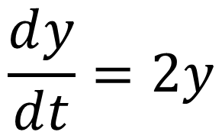
Examining mathematical models
Interpreting differential equations
$$\frac{ⅆy}{ⅆt}=2$$
$$\frac{ⅆy}{ⅆt}=2t$$
$$\frac{ⅆy}{ⅆt}=2y$$
Define your variables
Think about units

Slide 21
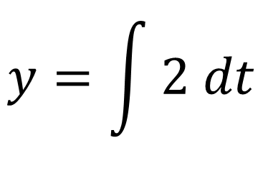
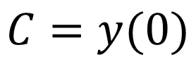
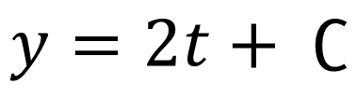
Examining mathematical models
Interpreting differential equations
$$\frac{ⅆy}{ⅆt}=2$$
Linear growth
y= Number of ducks
t= Time in years
$$y=\int{2 dt}$$
$$y=2t+ ∁$$
$$C=y(0)$$

Slide 22
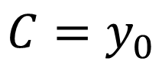
Examining mathematical models
Interpreting differential equations
Linear growth
$$\frac{ⅆy}{ⅆt}=2$$
y= Number of ducks
t= Time in years
$$y=\int{2 dt}$$
$$y=2t+ ∁$$
$$C=y_{0}$$

Slide 23
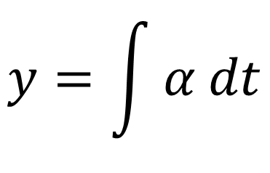
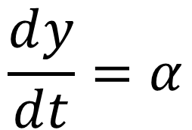
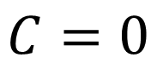
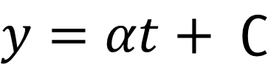
Examining mathematical models
Interpreting differential equations
Linear growth
$$\frac{ⅆy}{ⅆt}=α$$
$$y=\int{α dt}$$
$$y=αt+ ∁$$
$$C=0$$

Slide 24
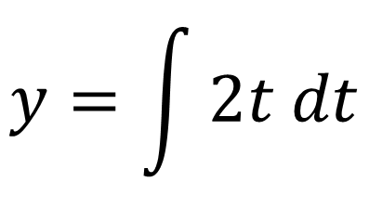
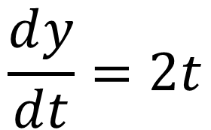
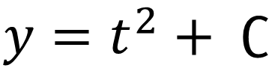
Examining mathematical models
Interpreting differential equations
Another growth example
$$\frac{ⅆy}{ⅆt}=2t$$
$$y=\int{2t dt}$$
$$y=t^{2}+ ∁$$
$$C=y_{0}$$

Slide 25
Examining mathematical models
Interpreting differential equations
Another growth example
$$\frac{ⅆy}{ⅆt}=2t$$
$$y=\int{2t dt}$$
$$y=t^{2}+ ∁$$
$$C=y_{0}$$

Slide 26
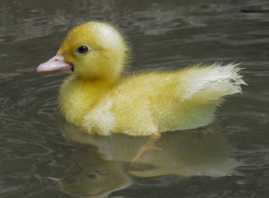
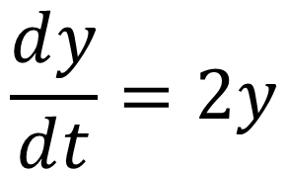
Examining mathematical models
Interpreting differential equations
Exponential growth
$$\frac{ⅆy}{ⅆt}=2y$$

Slide 27
Examining mathematical models
Interpreting differential equations
Exponential growth
$$\frac{ⅆy}{ⅆt}=2y$$
Separable differential equation

Slide 28
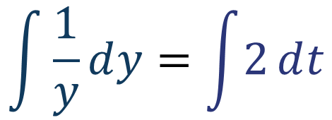
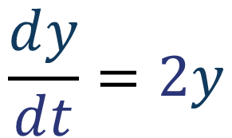
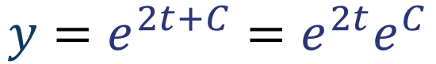
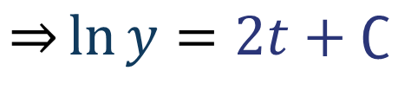
Examining mathematical models
Interpreting differential equations
Exponential growth
$$\frac{ⅆy}{ⅆt}=2y$$
Separable differential equation
$$\int{\frac{1}{y}ⅆy}=\int{2ⅆt}$$
$$\overset{⇒}{}\ln{y}=2t+∁$$
$$y=ⅇ^{2t+C}=ⅇ^{2t}ⅇ^{C}$$

Slide 29
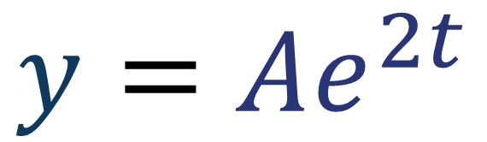
Examining mathematical models
Interpreting differential equations
Exponential growth
$$\frac{ⅆy}{ⅆt}=2y$$
Separable differential equation
$$\int{\frac{1}{y}ⅆy}=\int{2ⅆt}$$
$$\overset{⇒}{}\ln{y}=2t+∁$$
$$y={Aⅇ}^{2t}$$

Slide 30
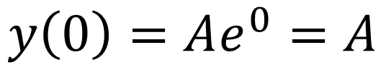
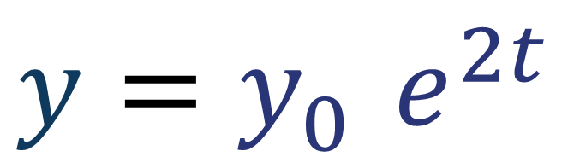
Examining mathematical models
Interpreting differential equations
Exponential growth
$$\frac{ⅆy}{ⅆt}=2y$$
Initial conditions
$$y={y_{0}^{}ⅇ}^{2t}$$
$$y\left(0\right)=Aⅇ^{0}=A$$

Slide 31
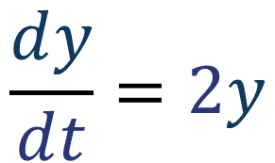
Examining mathematical models
Interpreting differential equations
Exponential growth
$$\frac{ⅆy}{ⅆt}=2y$$
Appearance
$$y={y_{0}^{}ⅇ}^{2t}$$

Slide 32
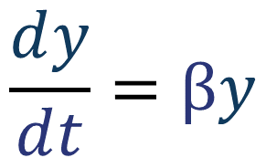
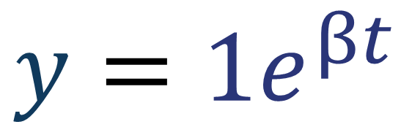
Examining mathematical models
Interpreting differential equations
Exponential growth
$$\frac{ⅆy}{ⅆt}=βy$$
In general
$$y={1ⅇ}^{βt}$$

Slide 33

Constructing mathematical models
Births
Deaths
$$\frac{ⅆN}{ⅆt}$$
Immigration
Emigration
Predation
Add terms to describe mechanisms in your system
Consider what will change your variable

Slide 34
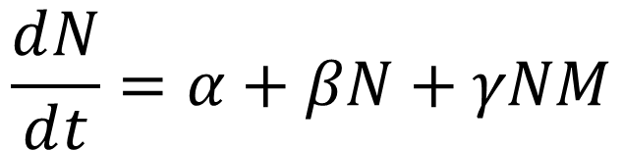
Constructing mathematical models
$$\frac{ⅆN}{ⅆt}=α+βN+γNM$$
Add terms to describe mechanisms in your system
Consider how it will change your variable

Slide 35
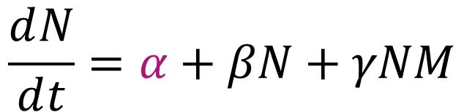
Constructing mathematical models
$$\frac{ⅆN}{ⅆt}=α+βN+γNM$$
Constant terms
Population independent effects
e.g. immigration, quota culling
Add terms to describe mechanisms in your system
Consider how it will change your variable

Slide 36
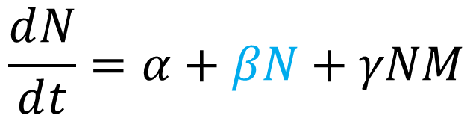
Constructing mathematical models
$$\frac{ⅆN}{ⅆt}=α+βN+γNM$$
Linear terms
Population dependent effects
e.g. simple births or deaths
Add terms to describe mechanisms in your system
Consider how it will change your variable

Slide 37
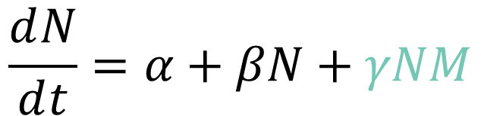
Constructing mathematical models
$$\frac{ⅆN}{ⅆt}=α+βN+γNM$$
Quadratic terms
Interaction dependent effects
e.g. infection intra-species competition
Add terms to describe mechanisms in your system
Consider how it will change your variable

Slide 38
Examining mathematical models
Solve
Simulate

Slide 39

Examining mathematical models
$$\frac{ⅆy}{ⅆt}=2$$
Initial condition: y=0 when t=0
Simulate

Slide 40
Examining mathematical models
$$\frac{ⅆy}{ⅆt}=2$$
Initial condition: y=0 when t=0
Simulate

Slide 41





How computers solve differential equations
Euler’s method
$$y\left(t+δt\right)=y\left(t\right)+δt\left(\frac{ⅆy}{ⅆt}\right)$$
$$y\left(t+δt\right)$$
Actual y
Error
Predicted y
$$y\left(t\right)$$
$$t$$
$$t+δt$$

Slide 42
Summary
Differential equations are equations describing continuous change
They can be used to describe abstractions of reality
The model can be built from components which affect how the dependent variable changes
We can solve and simulate these models in order to gain insight into the abstracted system they describe

